Slide 1
XM - Plus Studio MicroSD Control
internal
Application Department
Wesley Chen

Slide 2
Outline
Introduction XM-Plus MicroSD Control
MicroSD divide to Five Part
MicroSD Info
FPGA Setting
Display Initial
Display OFF
Image
Application Note ( Take MIPI as an example)
Introduce operate and download MicroSD
Generator Download File
Enter MicroSD Operate Interface
Check MicroSD Status and Read MicroSD Content
Download File To MicroSD

Slide 3
Outline - 1
Introduction XM-Plus MicroSD Control
MicroSD divide to Five Part
SDCard Info
FPGA Setting
Display Initial
Display OFF
Image

Slide 4
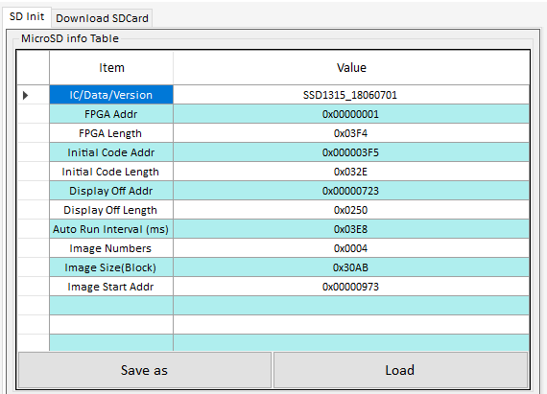
The first Part - MicroSD Info -1
MicroSD Info ( 30 Bytes ) have eleven Part, as follows
Item | Value
IC/Data/Version ( 2 Bytes ) | 16 char ( Fixed )
FPGA Addr ( 4 Bytes ) | start index of Block
FPGA Length ( 2 Bytes ) | Blocks
Initial Code Addr ( 4 Bytes ) | start index of Block
Initial Code Length ( 2 Bytes ) | Blocks
Display off Addr ( 4 Bytes ) | start index of Block
Display of Length ( 2 Bytes ) | Display off start Addr
Auto Run Interval ( 2 Bytes ) | Time slat between Images.
Image Numbers ( 2 Bytes ) | Total Image Number
Image Size ( 2 Bytes ) | Blocks per Image
Image Start Addr ( 4 Bytes ) | Start index of Block
+
User definition
+
+
User definition

Slide 5
The first Part - MicroSD Info - 2
IC/Data/Version could be key in 16 chars by user definition.
FPGA Addr be set to“1”.
Initial Code Addr equals FPGA Addr plus FPGA Length.
Ex : 0x00000002 = 0x00000001 + 0x0001 .
Display off Addr equals Initial Code Addr plus Initial Code Length .
Ex : 0x0000000B = 0x00000002 + 0x0009 .
Image Start Addr equals Display off Addr plus Display off Length .
Ex : 0x0000000C = 0x0000000B + 0x0001 .
Auto Run Interval could be key in Value by definition for timing set.
EX ：0x3E8 ( Hex ) = 1000m Sec ( Dec ) = 1 Sec.

Slide 6
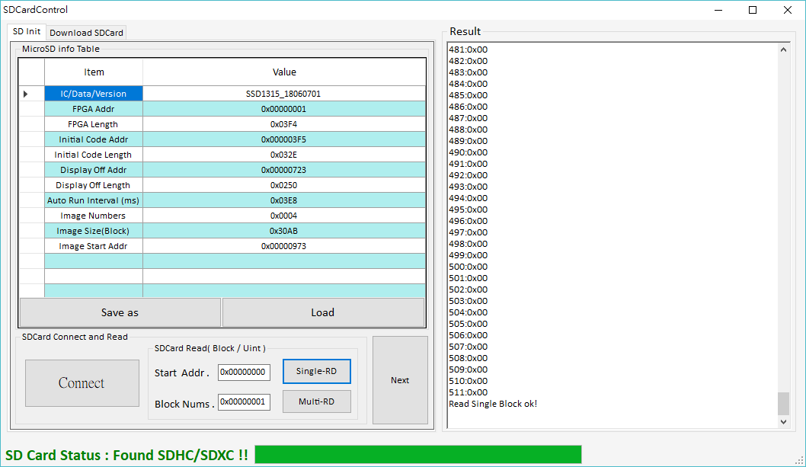
The first Part - MicroSD Info - 3
MicroSD info could be generated through read MicroSD ( The First Block;
Strat Addr. Must be set to 0x00000000 and Block Nums. Must be set to 0x00000001 )
Save MicroSD info to
txt file
Load txt file about
MicroSD info
Step1. Connect to
MicroSD
Step2. Read Block ( MicroSD info )
Result
Result

Slide 7
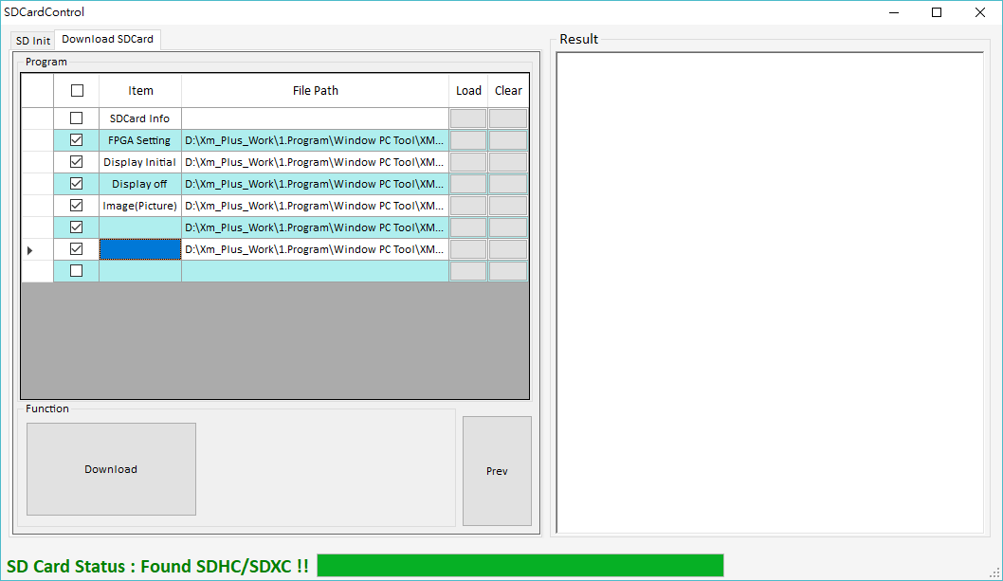
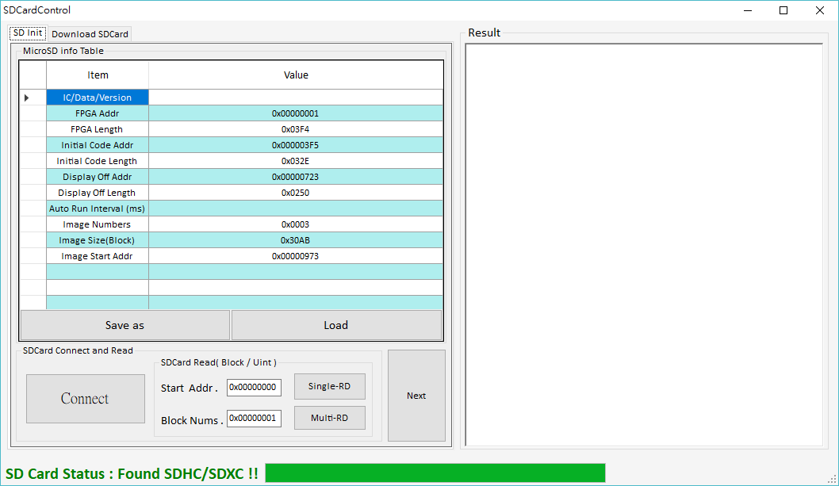
The first Part - MicroSD Info - 4
MicroSD info could be generated through load file in sequence ( MicroSD info ( not necessary )、FPGA Setting 、Display initial、Display off、Image ), as follows.
Step 1. load File
Step 2. load File
Step 3. load File
Step 4. load File
Step 5. load File
Step 6. load File
Key in chars by user definition
Key in Value by user definition
Save MicroSD info to
txt file
Switch to MicroSD
Table Form

Slide 8
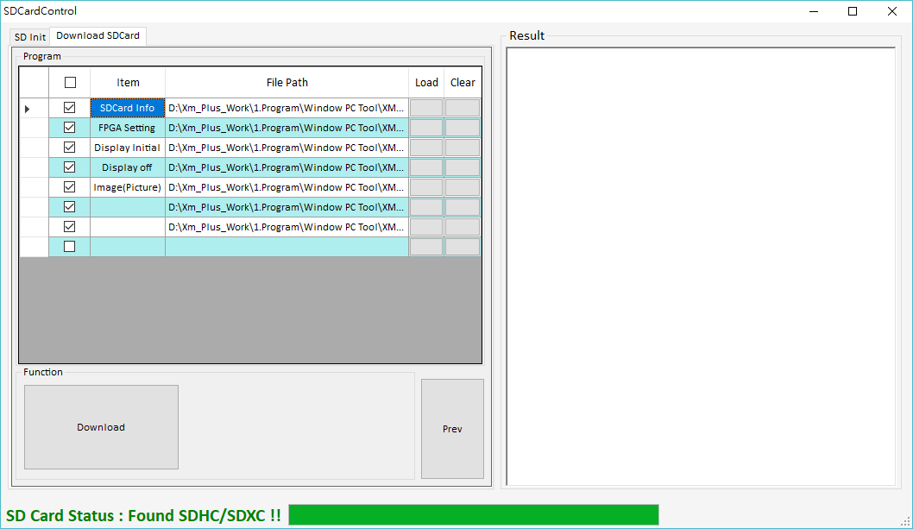
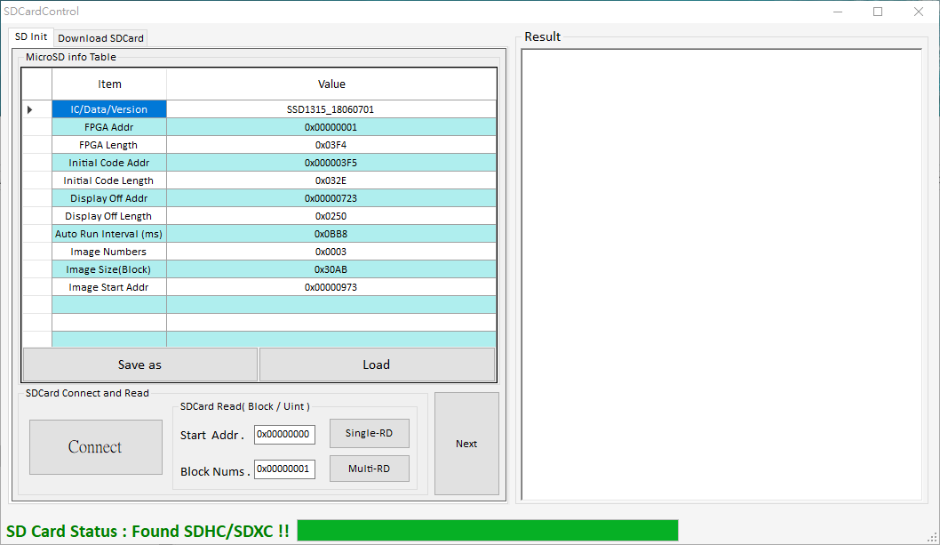
The first Part - MicroSD Info - 5
MicroSD info could be generated through load file in sequence ( MicroSD info ( not necessary )、FPGA Setting 、Display initial、Display off、Image ). If do not load MicroSD info ( txt file ). as follow.
Step 1. load File
Step 2. load File
Step 3. load File
Step 4. load File
Step 5. load File
Step 6. load File
Key in chars by user definition
Step 7. load File
Key in chars by user definition
Load files could be map to MicroSD info
Save MicroSD info to
txt file
Switch to MicroSD
Table Form

Slide 9
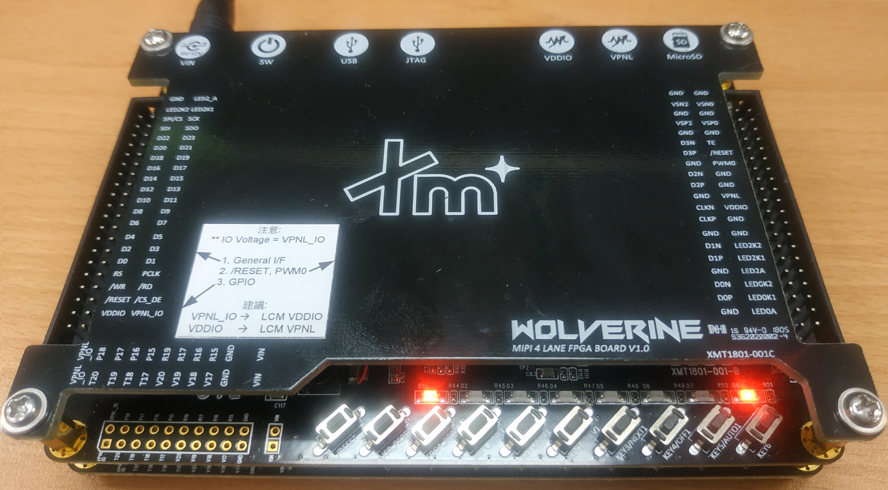
Second Part – MicroSD info
In this Case, When Enter MicroSD Mode ( Step 1 means keep FPGA_Reset Button once on the FPGA Board ), LED3 on and LED8 flashes means successful, FPGA Setting will be Execute Enter MicroSD Mode at first. It would be defined to set FPGA timing 、FPGA interface and so on.
Press

Slide 10
Third Part – Display Initial
In this case, if OTP( one time programming ) have no initial code then initial code need to be Written to chip, Thus Display initial part is necessary. When Press Button (KEY1/INT1) is Successful then LED3 off, it means Initial Code will be written to Chip through FPGA.
Press once

Slide 11
Fourth Part – Display Off
In this case, if let Display Panel will be off , we can Write Driver display off command ( 0x28 0x10 for Mipi ) to Chip, Thus Display off part is necessary. When Press Button (KEY4/OFF1) is Successful then Display Panel is off, it means Command will be written to Chip through FPGA.
Press once

Slide 12
Fifth Part - Image
in this case, let Display Panel shows Images, there are three buttons to execute
different Function, as follow.
Press Button (KEY2/PREV1) means show previous image.
Press Button (KEY3/NEXT1) means show next image.
Press Button (KEY5/AUTO1) means auto Switch images to show.
Press once

Slide 13
Outline - 2
Application Note ( Take MIPI as an example)
Introduce operate and download MicroSD
Generator Download File
Enter MicroSD Operate Interface
Connect to MicroSD and Read MicroSD Blocks
Download File To MicroSD

Slide 14
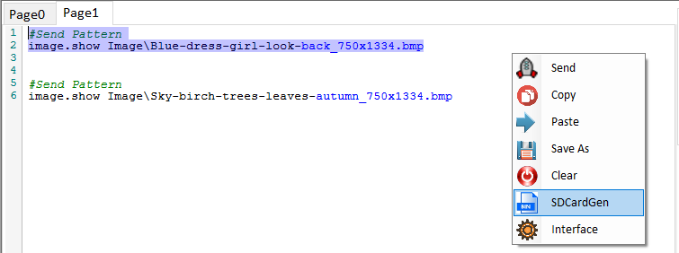
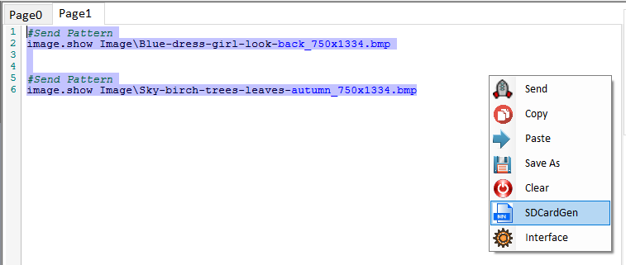
Generate Download File - 1
Open XM-Plus Display Studio.exe and Switch to verification page, load Script File to or Key in the Script Command to page form, then Generate Download File for certain Script command which is selected.
There three Generate rules need to notice, as follow.
MicroSD Download File be not Generated that more than one image once.
Result : OK
Result : Fail

Slide 15
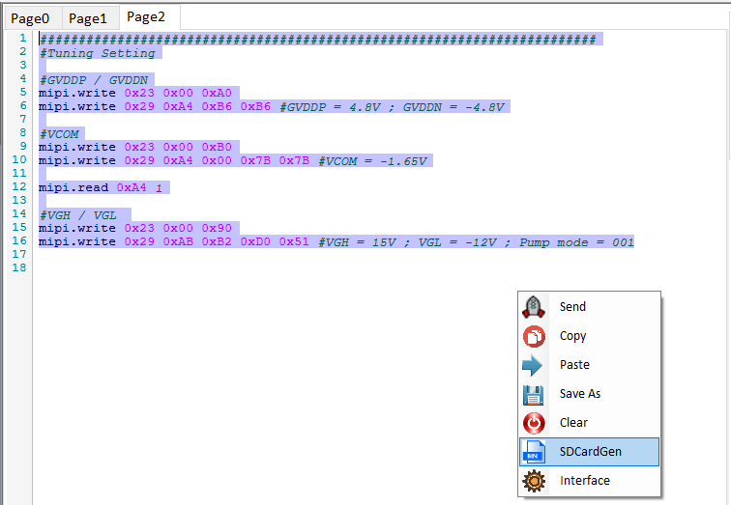
Generate Download File - 2
MicroSD Download File be not Generated that Name of command include string means “read” .
Result : Fail

Slide 16
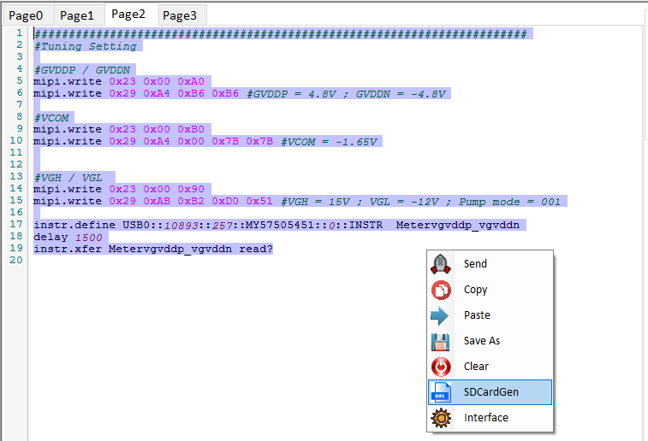
Generate Download File - 3
MicroSD Download File be not Generated that command would not be used about
FPGA Board Control, for example : Equipment.
Result : Fail

Slide 17
Generate Download File - 4
MicroSD Download File be not Generated that command would not be used about
FPGA Control, for example : Equipment.
Result : Fail

Slide 18
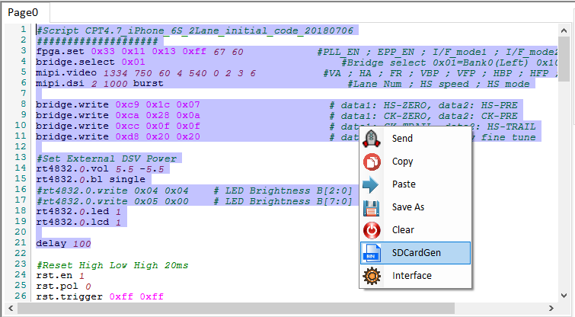
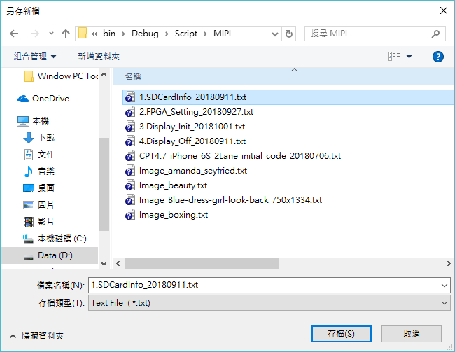
Generate Download File - 5
in this Case , Generate download file for certain Script command which is selected.
For example : Generate Download file for Script command with Image.
Save file path by user definition

Slide 19
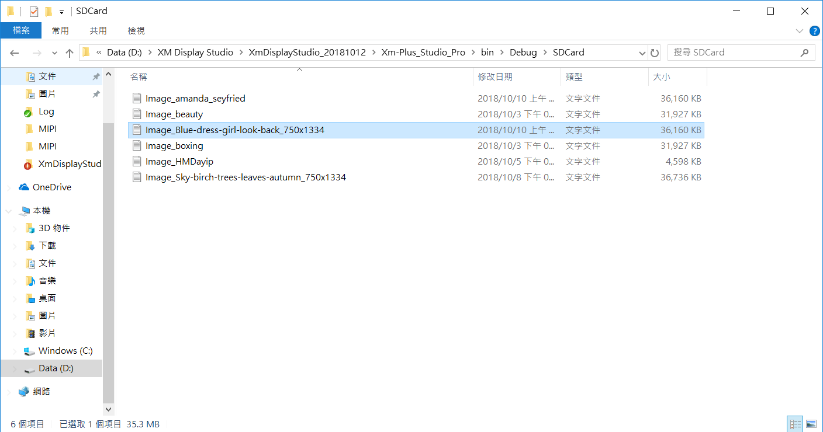
Generate Download File - 6
in this Case , Generate download file for certain Script command which is selected.
For example : Generate Download file for Image , Auto save Download file to document (SDcard).
Save file path by user definition

Slide 20
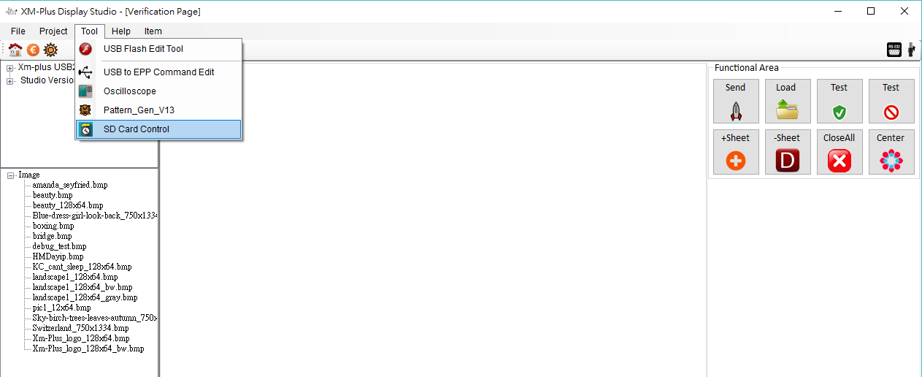
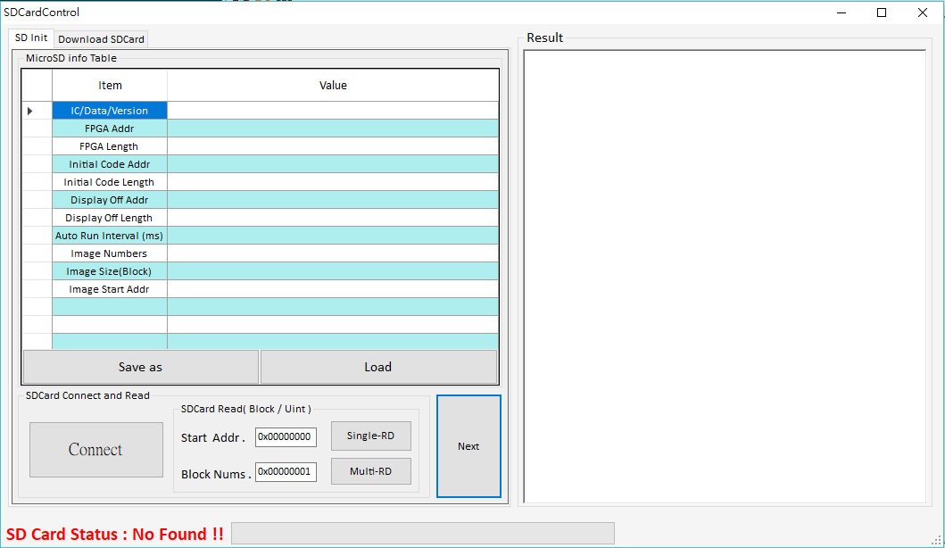
Enter MicroSD Operate Interface
MicroSD Download File be not Generated that command would not be used about
FPGA Control, for example : Equipment.
Enter MicroSD Operate Form
Open New Form

Slide 21
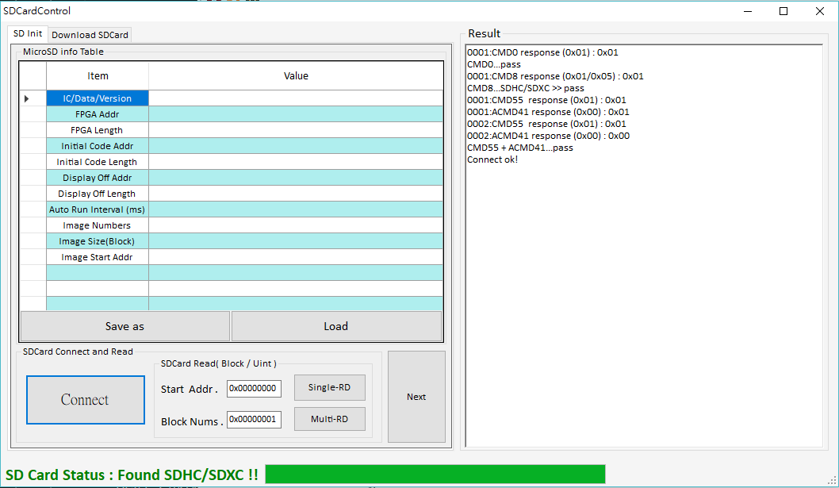
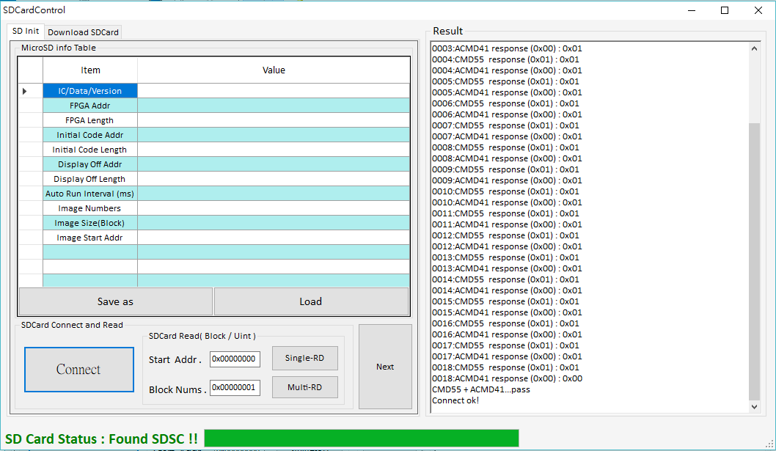
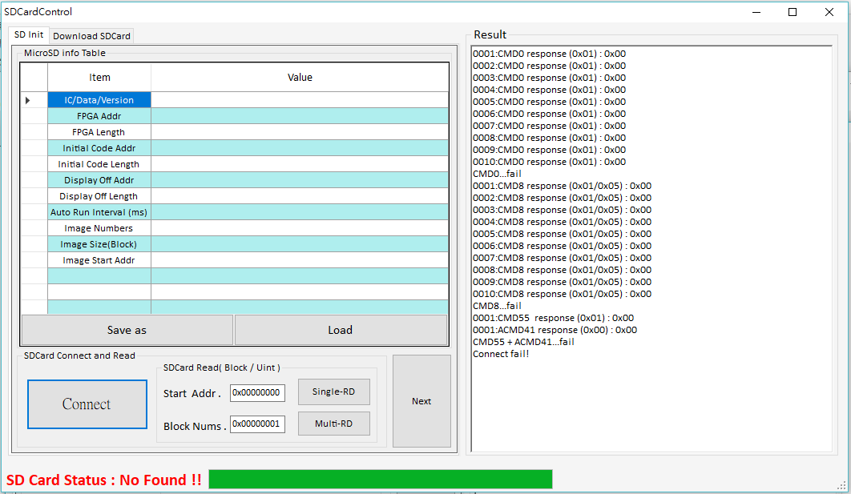
Connect to MicroSD and Read MicroSD Blocks - 1
Press button ( Connect ) to connect MicroSD , if Connect is successful then MicroSD
status is showed ( Found SDHC/SDXC or Found SDSC ).
Result : OK
Result : OK
Result : Fail

Slide 22

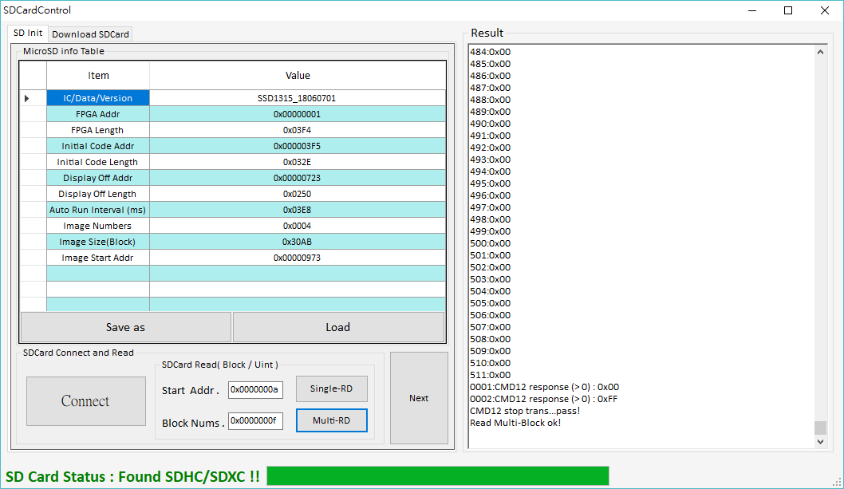
Connect to MicroSD and Read MicroSD Blocks - 2
Read MicroSD one block is 512 bytes once and it is fixed, it can not be modified
block Size, Read MicroSD Blocks have two mode, one mode is single read block, the other is Multi-Read Blocks, as follows.
OK
Result : OK
Result : OK

Slide 23
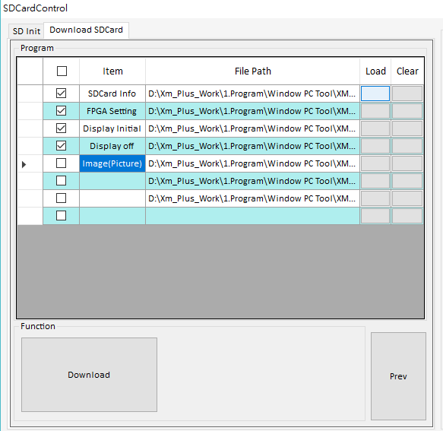
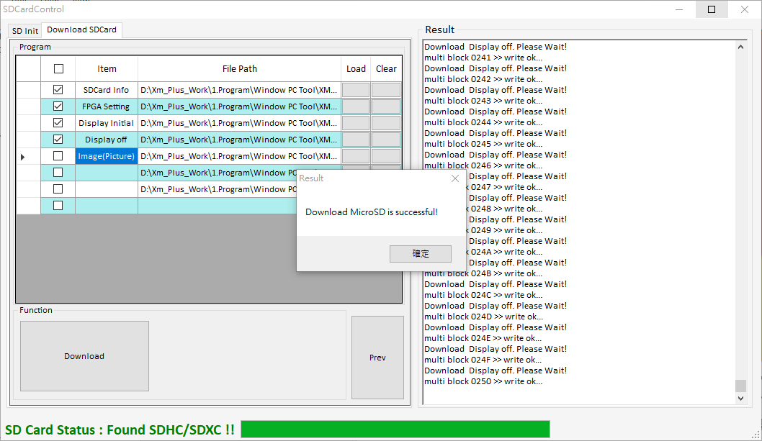
Download File to MicroSD
If Generate Download file is all successful, then load files in sequence. Press button (“ Download ”) to Execute Download MicroSD. Result Form will show on Screen Finally.
Step 1. load File
Step 2. load File
Step 3. load File
Step 4. load File
Step 5. load File
Step 6. load File
Step 7. load File
Step8. Execute

Slide 24
谢谢大家 !

